Slide 1

HTC Keyera Amazon Web Services
Team 16:
Sameer Kamran
Abrar Rehan
Muzammil Saleem
Noor Syed
Shreya Shah

Slide 2
Agenda
Problem Statement
Solution Introduction
Keyera Flow
Emissions Analytics
Conclusion

Slide 3
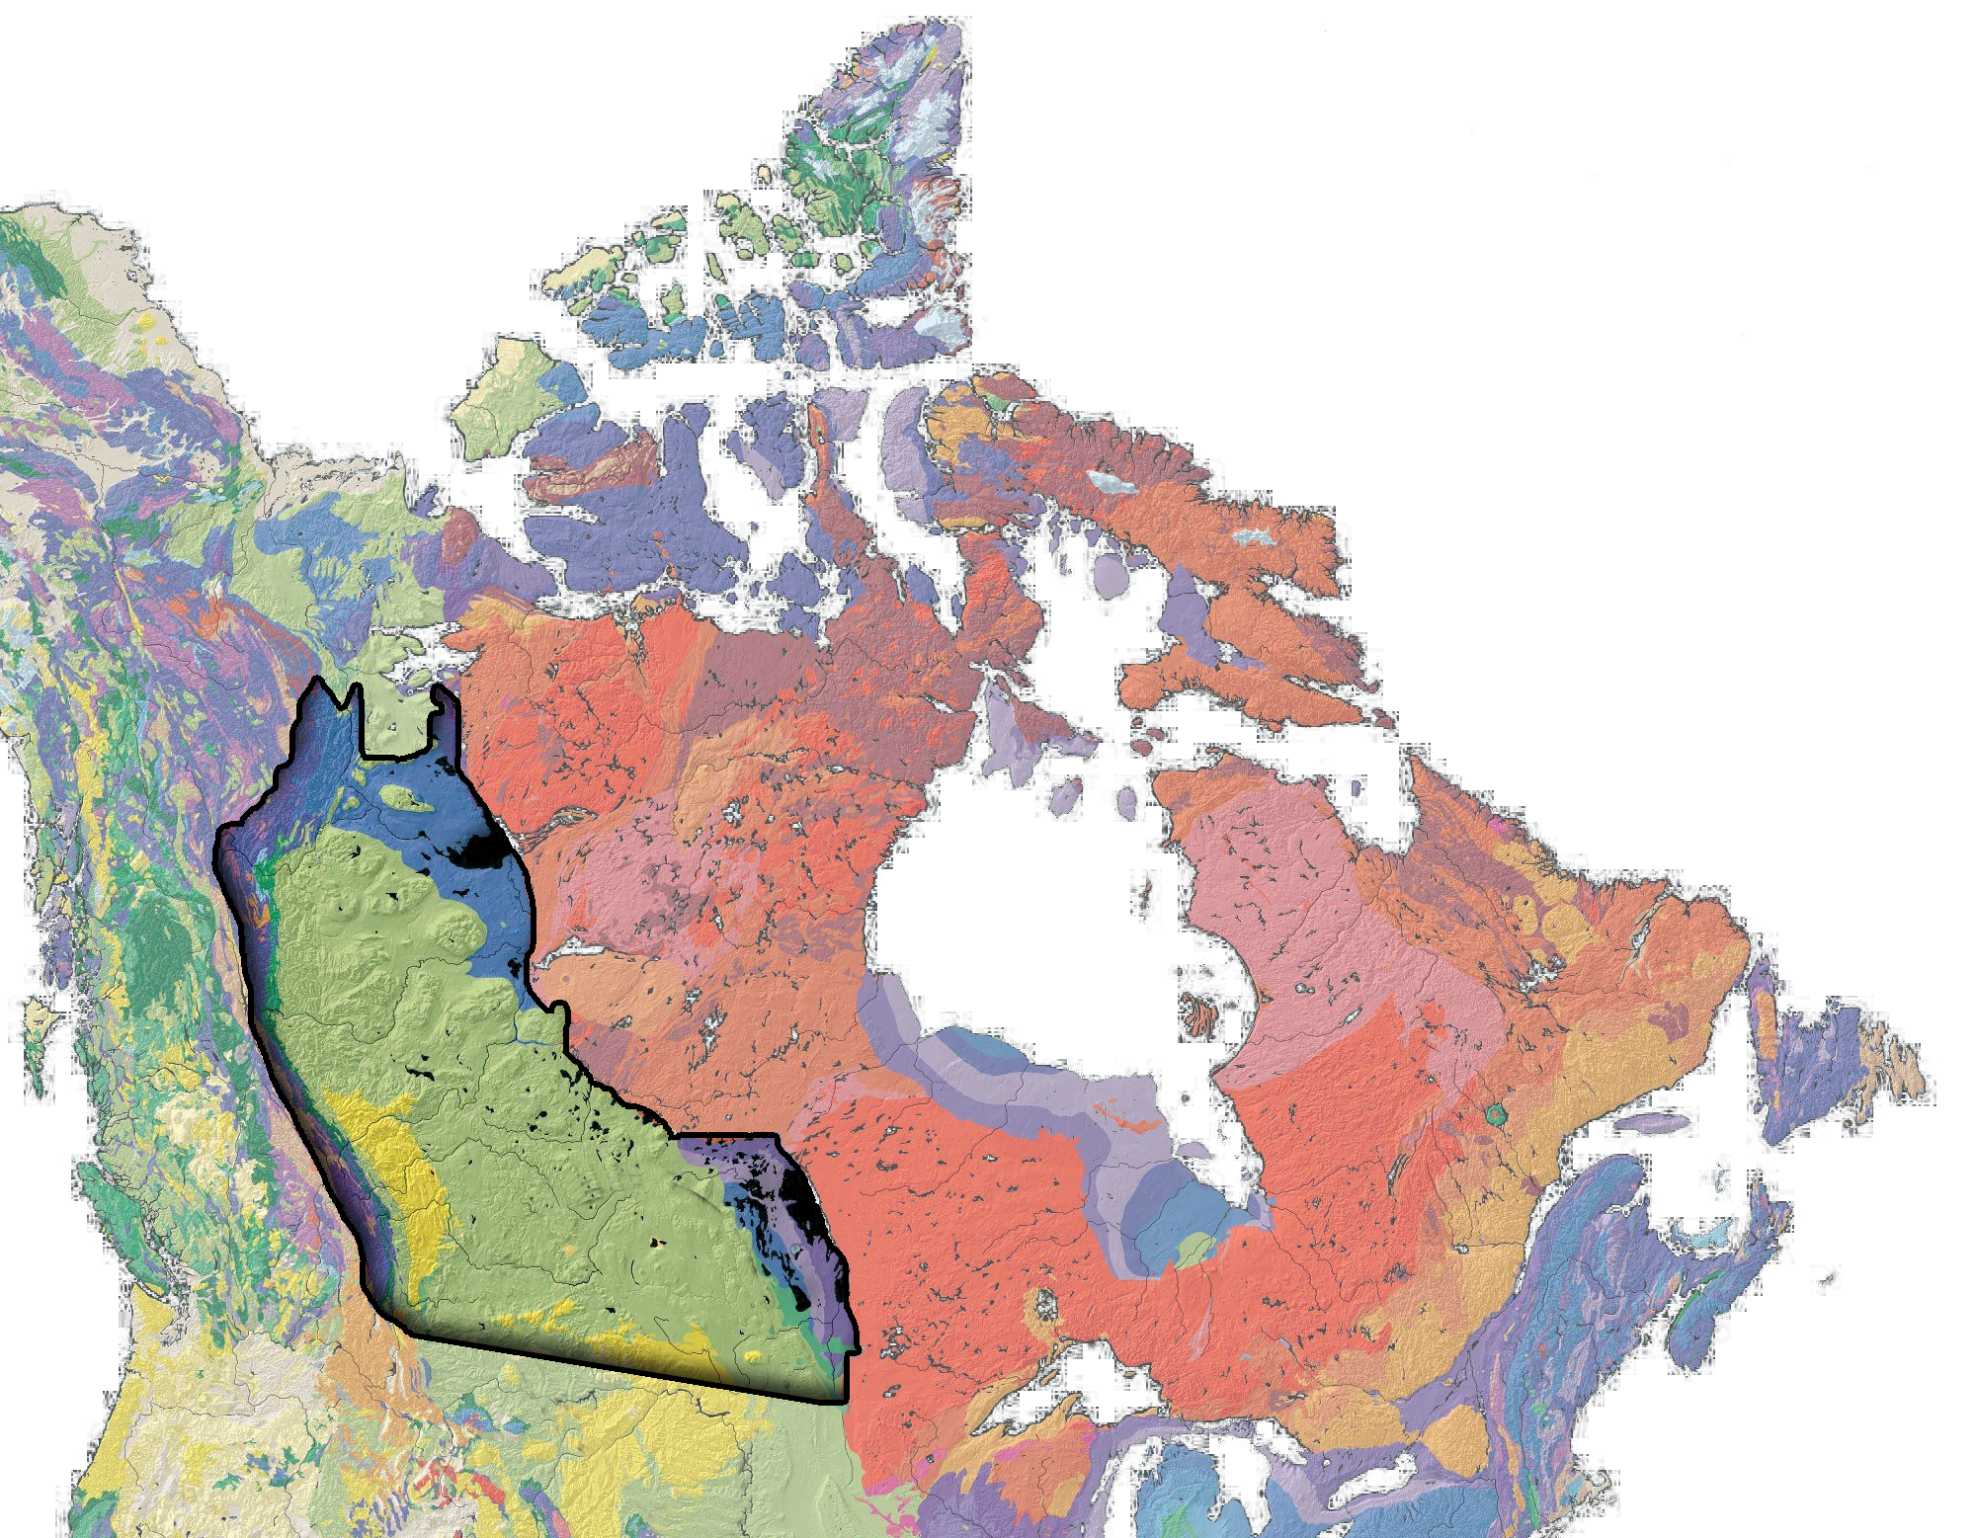
Problem Statement
Keyera’s Expanding Role: Storing, processing, and marketing natural gas & NGLs with a focus on innovation & sustainability.
Western Canadian Sedimentary Basin:
600+ active gas plants generating vast amounts of critical data.
A high-growth region for the energy sector.
Current Challenge:
Data is readily available but manual, time-consuming, and inefficient to analyze.
Slows down decision-making and operational optimization.
The Need:
A faster, more dynamic way to analyze and act on this information.
A centralized system for storing, managing, and analyzing data to drive informed decisions.
Notes:
With an expanding reach in the energy sector, Keyera is a dynamically growing business focused on storing, processing, and marketing natural gas and natural gas liquids (NGLs). But the focus extends beyond basic functions—there is a clear priority on innovation and sustainability, ensuring the energy infrastructure evolves effectively for a better future.
The Western Canadian Sedimentary Basin has over 600 active gas plants, each generating a number of critical metrics—making it a promising region for growth in the energy sector.
While all this information is readily available, extracting insights from it remains manual, time-consuming, and inefficient.
To accelerate innovation and remove roadblocks, there is a need for a faster, more dynamic way to analyze and act on this information.
Ultimately, a system is required that can store and manage this valuable data ensuring detailed analytics—allowing for the most informed decision-making

Slide 4

Our Goal
Goal: Develop an AWS QuickSight dashboard to help Keyera store, access, and analyze critical data efficiently.
Impact: Saves time, resources, and increases efficiency, aligning with Keyera’s five core values.
Core Dashboard Features:
Key operational metrics for data-driven decision-making.
User-friendly navigation for seamless data access.
Beyond the Requirements:
Conducted sustainability & environmental impact analytics.
Identified areas for process improvement to enhance efficiency.
Because without sustainability, there isn’t a future to innovate.
Notes:
Our goals were to create a dashboard using AWS’s Quicksite that can help Keyera’s growing business venture store and navigate the necessary data with ease. This will ultimately save the company time, resources and increase efficiency and fulfill the five core values.
To create the dashboard we were asked to consider a number of crucial features. And after brainstorming an approach to display these requirements, our team also decided it would be important to also conduct analytics on the sustainability and environmental impact of the current processes to identify areas where it can be improved. Because without sustainability, there isn't a future to innovate.

Slide 5
Keyera Flow: - The Geographic Map and Query Selected - Name Plate Capacity - Utilization Rates
Name Plate Capacity:
Donut Graph displaying the License Capacity .of Raw Gas for different plants
Cochrane Straddle and Empress Straddle Plants are the two plants with the greatest capacity
Utilization Rate:
Computed using the throughput gas and license capacities for different plants
The lower rates indicate that the license capacity of the plant is not being utilized to its full potential.
May highlight regions for improvements
Map and Queries:
A geographical map that is interactive and different filters to produce query specific results.

Slide 6
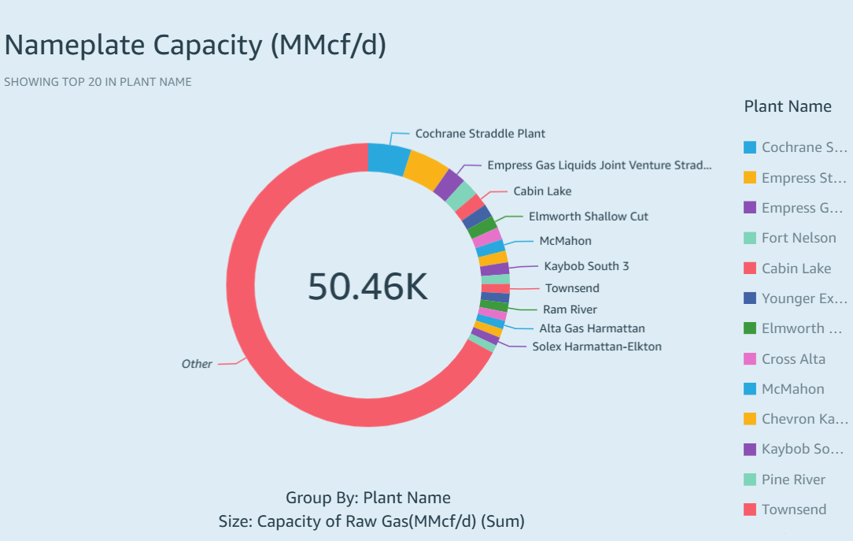
Highest Nameplate Capacity Cochrane Straddle Plant

Slide 7
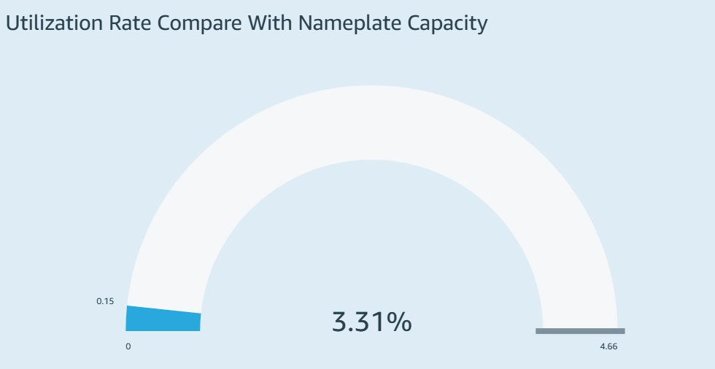

Slide 8
Keyera Flows: - Last Month's Throughputs - NGL Component Yields -Total Liquid Component Yields
Last Month's Throughputs:
Pie Chart displaying the processed gas transported from the different plant facilities.
Along with the utilization rate, can be used to identify areas that are not being used to their full potential.
NGL Component Yields:
Four pie charts displaying the different liquid yields for 4 NGL components that are transported to users.
Identifies the plants with highest output, indicating regions where capacity may want to be expanded to take adavntage of this.
Total Liquid Component Yields:
The sum of NGL liquid compnents produced by each plant. Along with individual component yields, can identify plants that may not be used to their full potential.

Slide 9
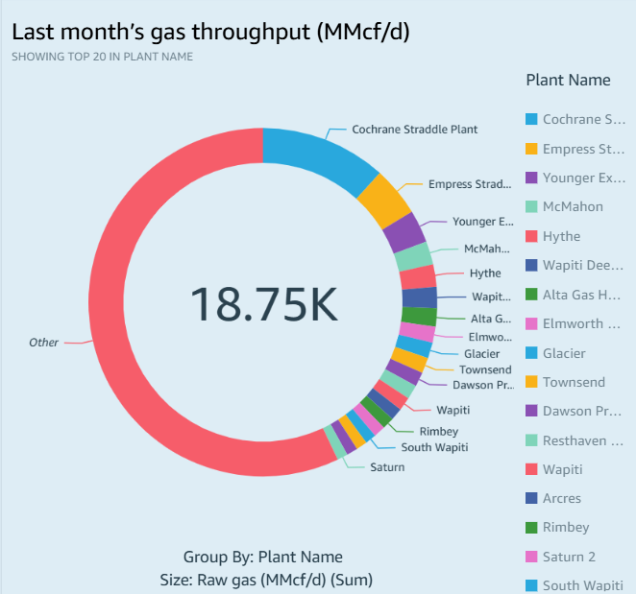
Last Month's Throughput

Slide 10
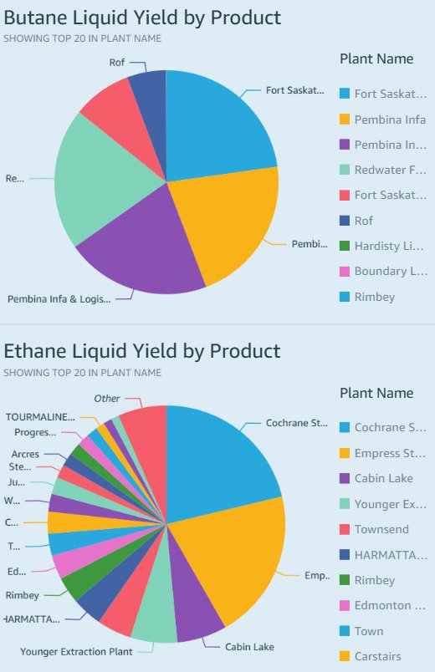
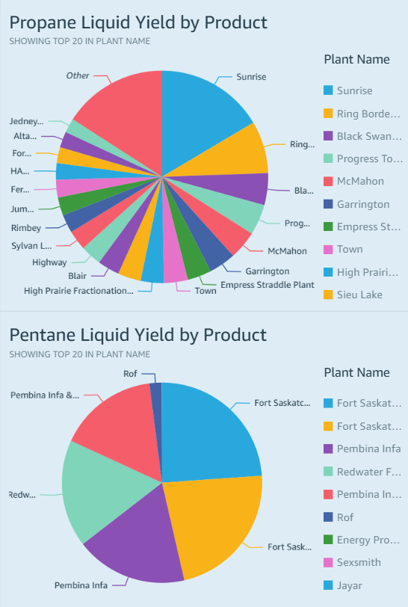

Slide 11
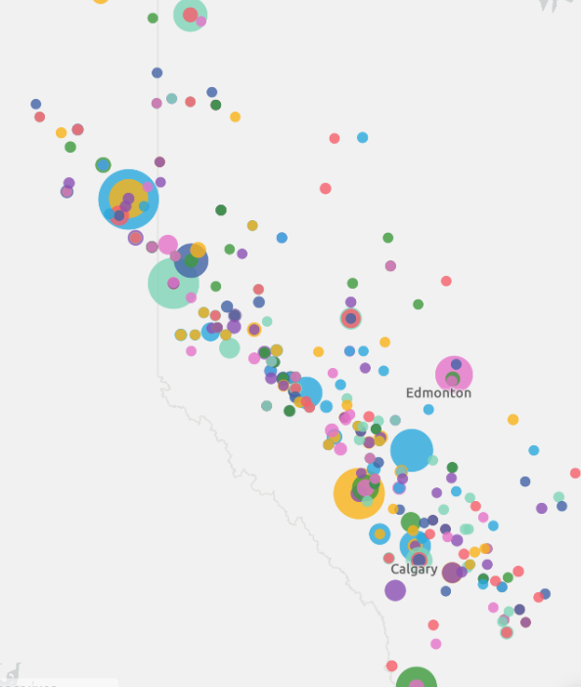
Greenhouse Emissions Monitoring
This dashboard provides an in-depth analysis of greenhouse gas emissions across multiple facilities in the oil and gas sector. It allows us to identify high-emission sites, analyze methane leakage and flaring inefficiencies, and compare emissions intensity across different locations.
Components :
Geographic Emissions Overview (Map)
Key Performance Indicators (KPIs)
Flaring Inefficiency Analysis
Methane Leakage Rate Analysis
Emissions Breakdown by Facility
Notes:
With an expanding reach in the energy sector, Keyera’s dynamically growing businesses have several functions and processes. Keyera is a leading midstream energy company, specializing in storing, processing, and marketing natural gas and natural gas liquids (NGLs). Keyera’s main goals are to: store, process and market Canadian energy resources.Their focus extends beyond operations—they prioritize innovation and sustainability, ensuring that energy infrastructure evolves efficiently. The Western Canadian Sedimentary Basin has over 600 basins, each with their own countless metrics , a promising region for growth in the energy sector that ultimately requires a dynamic system to perform analytics and store valuable information. While this information is currently available for companies, Extracting insights from this dataset is currently manual, time-consuming, and inefficient.

Slide 12
Geographic Emissions Overview :
A geospatial bubble map displaying total greenhouse gas (GHG) emissions (CO₂e) by facility location.
Bubble size represents total emissions, and colors differentiate companies or facility types.
Clicking on a facility dynamically filters the entire dashboard, updating other charts to focus on that specific site.
Helps pinpoint emission hotspots and facilities that may require intervention for emission reduction strategies.
Key Performance Indicators:
Five large KPI tiles summarizing critical emissions metrics: CO₂ Emissions, CH₄ Emissions, Total Emissions, Flaring Index & Methane Leakage Rate
Provides an at-a-glance summary of emissions trends across all facilities

Slide 13
Flaring Inefficiency Analysis
A ranked bar chart displaying the Flaring Index for each facility.
Helps identify plants with poor gas combustion efficiency, enabling targeted solutions like flare gas recovery systems.
Methane Leakage Rate Analysis
A ranked bar chart showing methane leakage rates across facilities.
Enables early detection of pipeline leaks, reducing both emissions and financial losses.
Emissions Breakdown by Facility:
A stacked bar chart displaying emissions composition per facility, segmented by gas type.
Provides a detailed emissions profile for each facility, helping identify key areas for reduction efforts.

Slide 14
Wrap-up

Slide 15
Thank you for your time

